Slide 1
第7章 认证加密和Kerberos
More Symmetric Crypto
Authenticated encryption and KERBEROS

Slide 2
认证加密模式
新的对称加密模式： Provide both confidentiality and authenticity
AE: Authenticated Encryption (认证的加密)
AEAD: authenticated encryption with additional data（not encrypted）（带有附加数据的认证加密）
The mode both encrypts and authenticates data with a single key.
The encryption and authentication is integrated; there is no need to worry about when to do what (i.e., Encrypt-Then-MAC vs. MAC-Then-Encrypt).
AEAD includes authentication over data that is not encrypted.

Slide 3
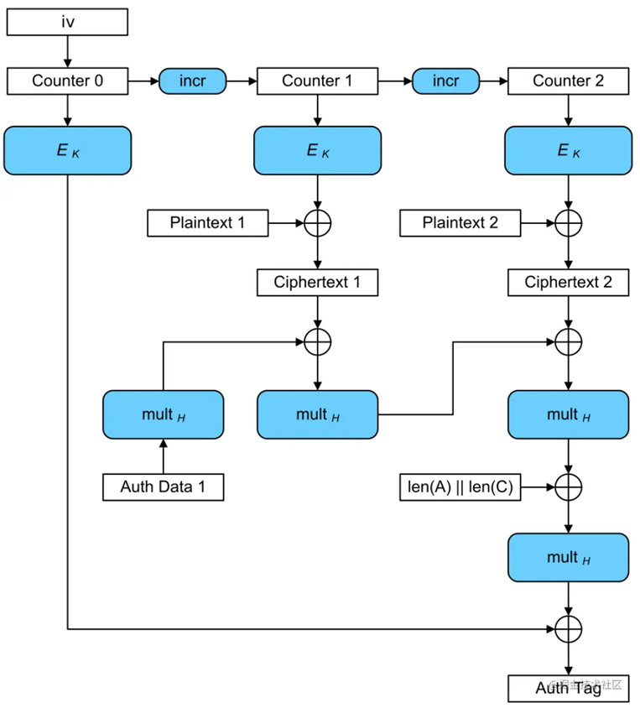
AES-GCM (Galois/Counter Mode)模式 (AES-CTR+GMAC)
AES-CTR：AES计数器加密模式
GMAC (Galois message authentication code mode, 伽罗瓦消息认证码)：用伽罗瓦域(Galois Field，GF，有限域)乘法运算计算消息的MAC
加密认证过程：
AES-CTR Encryption:
A series of 128-bit counters is encrypted using the block cipher E with key K (E_{k}); The results are combined using bitwise XOR with 128-bit plaintext blocks, producing a series of ciphertext blocks.
GMAC:
The Additional Data and these ciphertext blocks are combined using multiplication with a key-dependent constant H in the Galois field GF(2¹²⁸) to produce the authentication tag.
参考：https://juejin.cn/post/6844904122676690951

Slide 4
Typical programming interface for an AEAD implementation
Encryption
Input: plaintext P, a key K, and some associated data AD (additional authenticated data, AAD in plaintext that will not be encrypted, but will be covered by authenticity protection ).
It encrypts the plaintext using the key to produce ciphertext C
Then computes an authentication tag T from the ciphertext and the associated data (which remains unencrypted).
Output: ciphertext and authentication tag (message authentication code or MAC).
Decryption
Input: ciphertext C, key K, authentication tag T, and a header (AD) .
It decrypt the ciphertext C to recover the plaintext P
Then check the tag T to ensure that neither ciphertext nor associated data AD were tampered with.
Output: plaintext, or an error if the authentication tag does not match the supplied ciphertext or header.

Slide 5
其它的认证加密模式
AES-CCM： AES CTR和CBC-MAC的结合
ChaCha20-Poly1305 ： 作为AES的替代
ChaCha20： a stream cipher
Poly1305: a MAC algorithm
Both are designed by Daniel J. Bernstein
示例代码

Slide 6
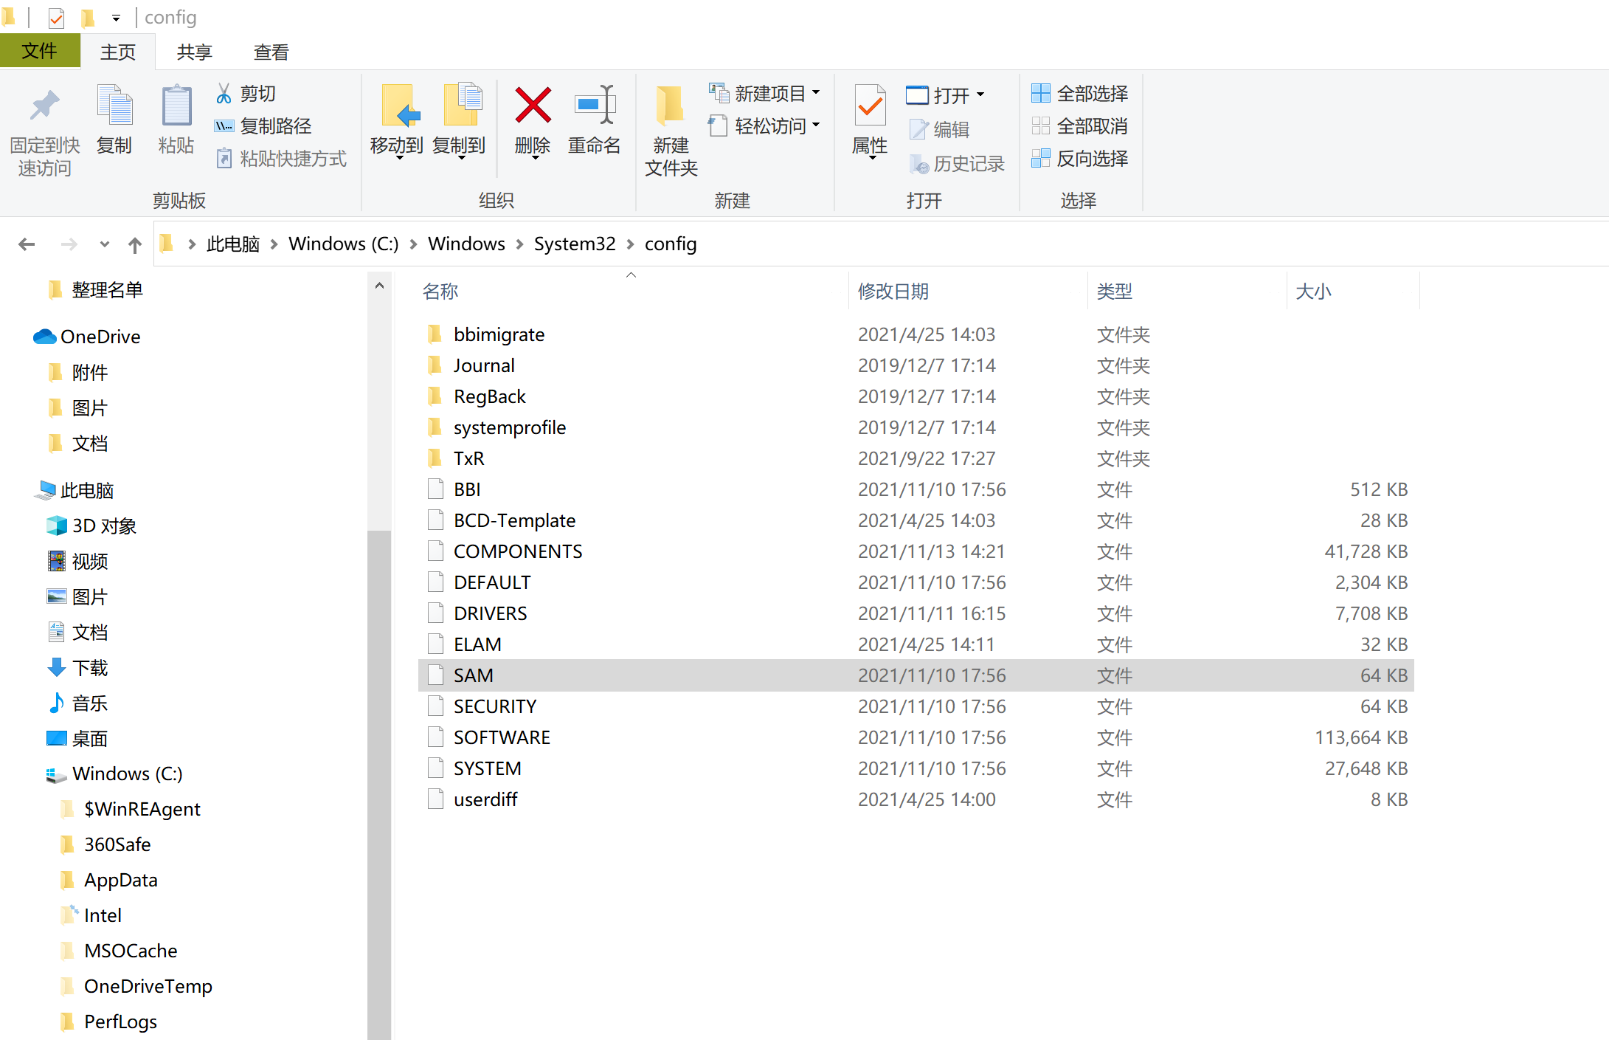
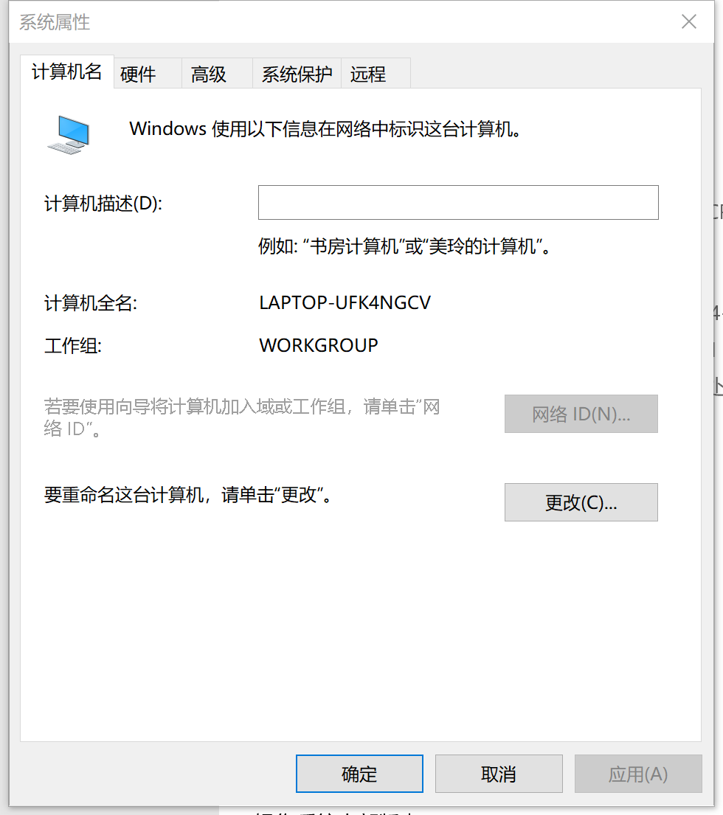
Windows认证授权
安全账户管理器SAM:
Security Account Manager
存储本机上所有用户的口令hash值；

Slide 7
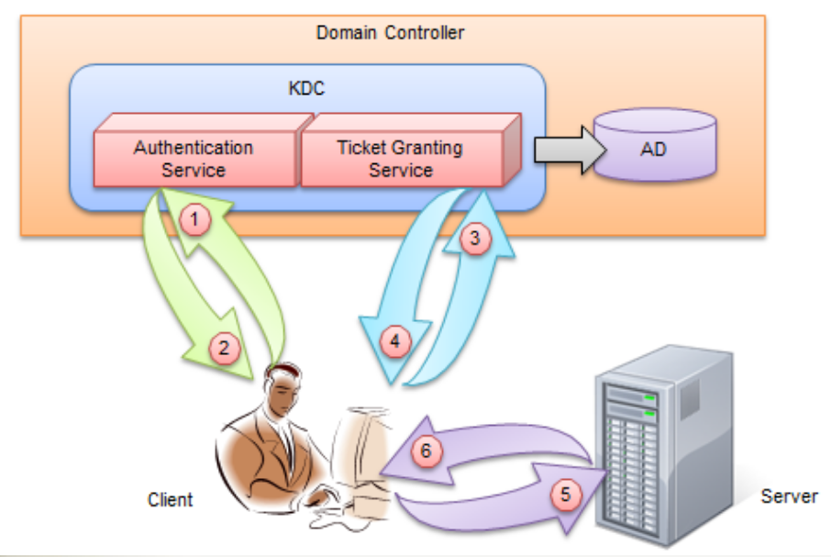
KERBEROS认证协议
使用对称加密来进行网络身份认证和授权的认证授权体系； AD: Account Database
Windows域是计算机网络的一种形式，其中所有用户帐户 ，计算机，打印机和其他安全主体都在位于称为域控制器的一个或多个中央计算机集群上的中央数据库中注册。 身份验证在域控制器上进行。 在域中使用计算机的每个人都会收到一个唯一的用户帐户，然后可以为该帐户分配对该域内资源的访问权限。
Kerberos：Client、 Server、 KDC
KDC: Key Distribution Center
AS: Authentication Service
TGS: Ticket Granting Service

Slide 8
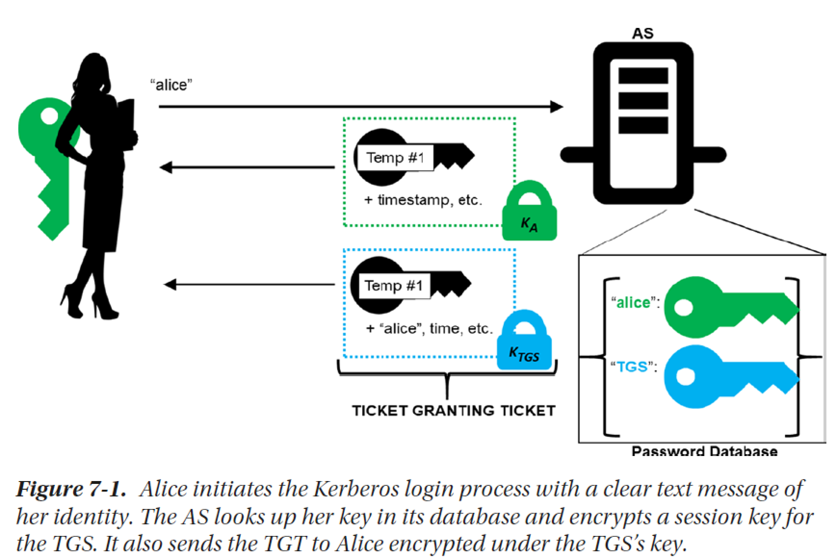

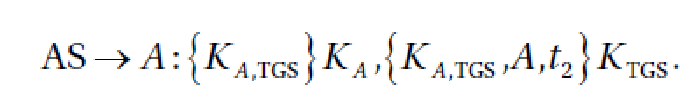
AS认证服务

Slide 9
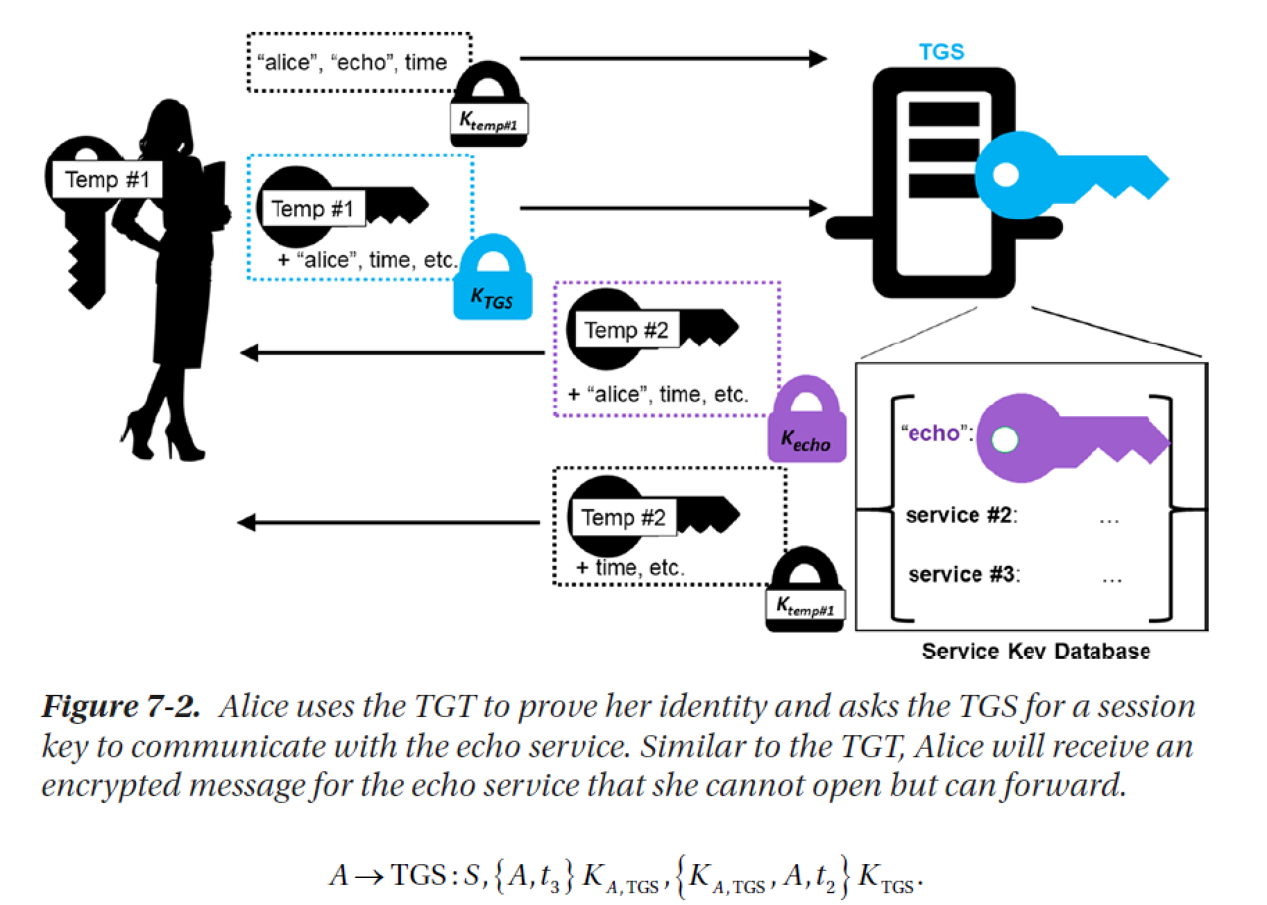

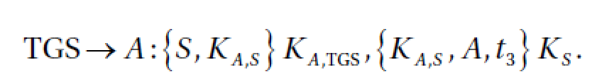
TGS授权服务

Slide 10
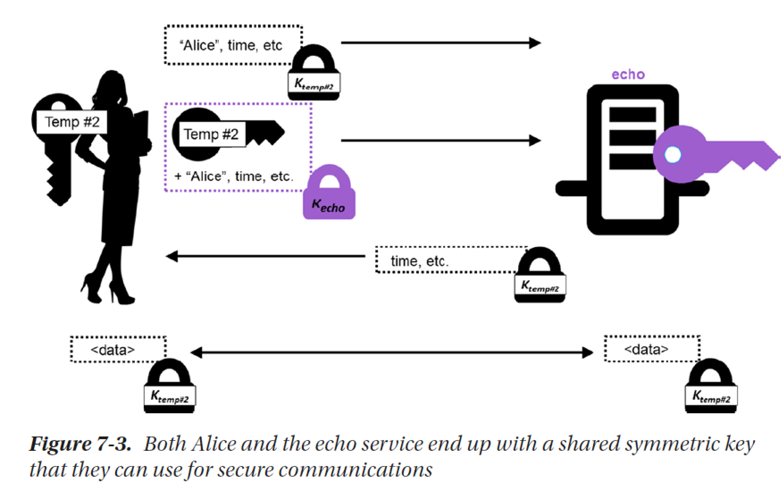
会话认证和密钥协商

